Slide 1
Common Core Standards: Helping Districts Go Deeper
Nancy S. Brownell, Senior Fellow,
Local Control and Accountability Team
RSDSS – January 20, 2015

Slide 2
Education has never been stagnant; the
Common Core and Smarter Balanced Assessments are part of ongoing, important progressions.
Now
“College and career readiness”
Measures individual student progress to ensure students have complex problem-solving skills that get them ready for careers and college
1990s & 2000s
1970s & 1980s
“Proficiency”
Boost every child to proficiency in reading and math and start gathering the data to understand student progress
“Minimum competency”
Ensure all HS graduates can demonstrate “minimum competency”
“ find we're very excited, our kids are ready for the transition. It's going to be a challenge, but it's exactly what our kids need to prepare for college and go out in the work-place.” Deputy Superintendent Long Beach Unified District
“Results show we look good, and we're going to get better.” Superintendent, San Marcos
On API: “It's a quality index of schools in California…It tells us a lot,” Long Beach teacher
  At each inflection point people have been nervous, but each time it has been the right action to move forward.

Slide 3
Common Core Adopted
Reviewed and adopted by the CA State Board in August, 2010
Pursuant to Senate Legislation
Vetted by Commission of practitioners and scholars
Natural next step to remodel our standards and focus on college, career and civic preparedness

Slide 4
California’s Vision for
PreK-12 Education
High quality teaching and learning in every classroom, active, engaging learning opportunities for all students, rigorous instruction and assessments guide planning and progress.
Built on the Common Core State Standards (CCSS), which bring California’s standards up to date to meet today’s college and career expectations.
Collaborative leadership from teachers, administrators and parents to develop local goals and priorities to best meet student needs for rigorous, imaginative learning expectations and success.
Ensure that all students, regardless of where they are from or where they live, graduate prepared for college and careers in the global economy of the 21st century

Slide 5
Common Core State Standards
Aligned with expectations for college and career success.
Clear, so that educators and parents know what they need to do to help students learn.
Consistent across participating states, so that students are not taught to a lower standard just because of where they live.
Include both content and the application of knowledge through higher-order thinking and problem solving.
Build upon strengths and lessons of earlier California standards and standards of top-performing nations.
Realistic, aligned across grades, focused on most important content for student success and achievement.

Slide 6
Students Who are College and Career Ready in Literacy
Demonstrate independence.
Build strong content knowledge.
Respond to the varying demands of audience, task, purpose, and discipline.
Comprehend as well as critique.
Value evidence.
Use technology and digital media strategically and capably.
Come to understand other perspectives and cultures.
From Introduction to Common Core ELA/Literacy Standards

Slide 7
Students Who are College and Career Ready in Mathematics
Demonstrate the academic knowledge, skills, and practices necessary to enter into and succeed in entry-level, credit bearing courses in college or technical courses; certificate or workplace training programs requiring an equivalent level of mathematics; or a comparable entry-level math course at the institution.
Modified Language from Smarter Balanced Definition

Slide 8
Different Types of Readiness
WORK Ready
Meets basic expectations regarding workplace behavior and demeanor.
JOB Ready
Possesses specific knowledge necessary to begin an entry-level position.
CAREER Ready
Possesses sufficient knowledge and skill and general learning strategies necessary to begin studies in a career pathway.
COLLEGE Ready
Is prepared in the four keys of college readiness necessary to succeed in entry-level general education courses.
Is prepared for success and economically viable career pathways in the 21st century economy.
LIFE Ready
David Conley

Slide 9
Key Aspects of the CCSS
Reading increasingly complex texts closely.
Communicating effectively across multiple media and content areas.
Using evidence; interpreting with justification.
Engaging in inquiry and research.
Engaging in mathematical practices that use mathematical reasoning in application.
Using mathematical skills across content areas and contexts.

Slide 10
California is in a
Unique Place
Local Control State
Local boards determine district curricula
CCSS state what students need to know and are able to do, instruction and curricula determined locally
California Curricular Frameworks provide extensive guidance

Slide 11
Key Messages Factual
We know that 60% of the careers today require some form of education after high school – a degree or certificate. This will only grow in the future.
We need to raise our academic standards and performance expectations.
We want our students go to schools with the most highly effective teachers, access to the best educational opportunities, and use of the best technology so they graduate prepared for college and/or the workforce.
The implementation of the (CCSS) supports our students to be college and career ready.

Slide 12
New Standards mean …
Changes in instruction
Changes in curricula and materials
New assessments, K12 and college
Changes in professional development
Educator preparation/evaluation
New ways to define and assess school and district success
Changes in K-12 finance (LCFF)

Slide 13
Opposition and Resistance Themes
Federal overreach
Use of data and privacy issues
Concerns about high stakes testing
Concerns about math instructional changes
Changing from the “way we have always taught”

Slide 14
California Assessment of Student Performance and Progress
The implementation of the California Assessment of Student Performance and Progress (CAASPP), including the Smarter Balanced Field Test, is another step toward our goal of college and career readiness.
The new assessments reflect expectations for more rigorous and complex learning and prepare students to demonstrate what they know and can do given the complexities of a changing world.
The assessment system connects learning to life after high school, aligned with college curricula and employer expectations.
The system supports teachers with a practical suite of resources and provides actionable and timely data for teachers, parents, and students to guide learning and growth.

Slide 15
Key Messages (CAASPP)
The implementation of the CAASPP system, including the Smarter Balanced Field Test, is an important step toward our goals.
The implementation of the CAASPP system, including the Smarter Balanced Field Test, provides incentives and opportunities to integrate CCSS and technology into classroom instruction.
More rigorous learning expectations requires more complex assessment items and ways of demonstrating knowledge, skills and applications.

Slide 16
Communications 101-Delivering Messages
As changes take place, resistance increases unless a consistent, encouraging message is offered and echoed.
For messages to “stick,” they must be repeated frequently and powerfully and tied to existing initiatives.
Clear and consistent messages need to increase knowledge and reduce fears and misconceptions.

Slide 17
CCSS Systems Implementation
(CCSS)
Leadership
Curriculum, Instruction, and Assessment
Professional Learning
Engagement & Communica-tion

Slide 18
Challenges Ahead
Understanding how the pieces fit together
Importance of setting priorities and allocating resources
Increasing digital literacy and instruction to support deeper learning
Communicating with parents and community members about the strengths of the district and where we are headed

Slide 19
Communication Priorities
C
Communicate the big picture in your district.
O
Operate in an organized, coordinated, transparent way.
R
Reach out and engage those who can lend support.
E
Engage with parents and other constituents early and often
Council of Chief State School Officers (CCSSO) August 2013 Meeting

Slide 20
Communication & Engagement
Now that we are implementing new, rigorous standards, it is even more crucial to communicate with internal and external audiences.
With whom do we need to communicate?
When do we need to communicate with them?
What information will they need, or have?
How will we provide or acquire needed information?

Slide 21
Key Educational Constituents and their “Stake” in Student Success
Group | What is at Stake?
Students | Personal success, future opportunity
Parents | Pride, success, opportunities for their students
School Staff | Personal efficacy and job satisfaction
School & District Staff | Professional efficacy and accountability expectations
School Board | Fulfilling the district’s mission, accountability
Tax Payers | Getting a good return on investment
Community | Community pride and “livability”
Business | Ability to hire graduates with needed skills, community economics

Slide 22
Key Questions for Messaging
What are the district/organization messages about (CCSS) implementation and the overall vision for student success?
To what extent are the goals and messages about the importance of the (CCSS) pervasive throughout the district/organization?
How are local constituents involved?

Slide 23

Avoid “Random Acts of Continuous Improvement”
Next “silver bullet”
Instructional Strategies
PLCs to support changes
Interesting workshops and professional development
Some grade levels and departments
Changing measures of success

Slide 24
Aligned Acts of Improvement
District multiyear,
multidimensional
LCAP
Governance & Leadership Teams: Setting & Communicating Direction
“Critical Selected”
GOALS
Community
Schools
Classrooms
PLC Teams
Students
The focus and vision are developed from common beliefs and values, creating a consistent direction for all involved.

Slide 25
Internal and External Stakeholders/Constituents
Internal – those who work within the school system on a daily basis and who largely control what goes on there. Includes teachers, administrators, staff, district leadership and staff, and school board members.

Slide 26
Internal and External Stakeholders/Constituents
External – those outside the day-to-day work of the schools who have a strong interest in school outcomes but who do not directly determine what goes into producing those outcomes.

Slide 27
Audiences & Levels of Engagement
Inform requires broad level of awareness and may also be influential with others | Consult need to have a good understand-ing and will provide input at key times | Involve have a high level of engagement and are involved in decision-making processes | Collaborate responsible for implementing and monitoring

Slide 28
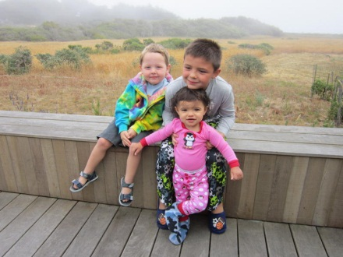
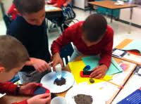



What will they be doing
five years after
graduation?

Slide 29
CDE Communications Toolkit
Introduction
Strategic Communications
Audience Mapping
Key Messaging Purpose and Tips
Audience Specificity
http://www.cde.ca.gov/re/cc/

Slide 30
Communication Tools
Use of the “educational orchestra” metaphor provides a counterpoint to the ongoing educational conflict narratives
Educational remodeling rather than reform is more concrete, slows magic bullet thinking
Future preparation, college and career readiness, orients the public toward a collective importance of a strong public education system

Slide 31
Great City Schools - Messages
Identify key audiences.
Develop a set of primary messages, secondary messages with more detailed information geared to particular audiences.
Connect with stakeholders through real-life examples of the common core in action.
Include messages that prepare stakeholders for an apparent drop in test scores.
Identify other likely stakeholder concerns and misinformation, and prepare messages in response.
In all messaging, link common core standards and assessments to other broad reforms underway in the district that will benefit children.
Communicating the Common Core Standards

Slide 32
Great City Schools - Messengers
Make sure classroom teachers know the local district goals and story.
Think of parents and community members not only as consumers of district communications but as communicators as well.
Equip all district staff to serve as messengers to the external community.
“Deputize” local businesses, universities, celebrity graduates, and others to speak on behalf about the value of raising the district’s academic standards.

Slide 33
What Do We Communicate?
Positive Changes (College & Career Readiness)
Consistent & Constant Messages
Focused on Simple Things First (Don’t make the Gap too big!)
Connect to Other Initiatives
Rationale (Why: Success for ALL Students)
Capture Community’s Imagination

Slide 34
Opposition Themes
Not Locally Developed
Takes control away from locals
Greater turmoil and confusion for teachers and students
“Massive unevaluated” experiment
May break the district’s bank – fiscally irresponsible
Federal intrusion into state and local decisions
Privacy and data collection issues

Slide 35
Opposition: Create Doubt
“Dubious college and career ready standards, undermine local control”
Data mining, “using our children”
National standards and tests
“Subjectivity and lowest common denominator pedagogy”
“Menace to our children and families”
Council of Chief State School Officers (CCSSO) August 2013 Meeting

Slide 36
Knowledge of (Common Core)
What does common core mean in the local context and community?
What is on district/school websites?
How does CCSS strengthen and extend existing initiatives?
Who are key district advocates?
What does the opposition understand/say/communicate?

Slide 37
Strategic Communications
Build on the effectiveness of current communication efforts.
Establish priority audiences and the best channels to reach them.
Define the image of your organization/district/schools by staff, parents, and other community members.
Implement two-way communication techniques that work for your district/organization.
Provide frequent, ongoing information desired by your priority audiences.

Slide 38
Need for Proactive Communication
Hold focus and parent group meetings
Provide messaging resources for Board
Distribute clear, understandable information in multiple languages
Engage business and religious leaders
Address the EMOTIONs of change in place before mastering the OPERATION of change
Coordination and consistency is key

Slide 39
So.. Key Fears to Address
As much as we fear the NEW…
We may fear giving up the OLD even more.
Habits, Mastered Content, Clarity and Practice…
Provide Comfort
Support Ego / Self Esteem
Organize Structure and Coherence
Within the Community and Schools

Slide 40
FrameWorks Institute
Dominant Media Frames Related to Education
Education is a consumer good.
Processes of learning are separated from the education system.
The Education System is in crisis.
Overarching Patterns in Media Coverage of Education Issues

Slide 41
Media Results
Presents a narrow story of education compared to what we want to tell.
While education’s problems are severe, effective reforms that improve outcomes get lost.
Breadth and nuances of success as well as optimism for improving education are missing from the media narrative.
Overarching Patterns in Media Coverage of Education Issues

Slide 42
California CCSS Communications and Capacity Building Campaign
(CCSS Campaign)

Slide 43
CCSS Campaign:
Primary Purpose
To create awareness about how the CCSS will positively impact teaching and learning, and to provide the education community, families, and the public with access to high-quality resources that have been developed in California and across the country.
Notes:
What we know about support for common core is that when people understand what the standards are, what they do and why they are needed, they are supportive. That’s why this is not a PR campaign, it is an effort to provide our education community with the resources they need to provide good information on the common core state standards.

Slide 44







Notes:
Each brings a unique perspective and strength and together represent almost 1 million members. And each is a critical part of the education system and serves as a strong voice.

Slide 45
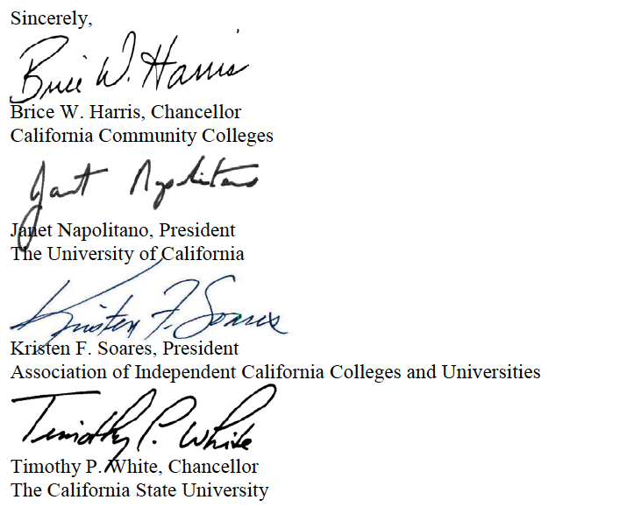
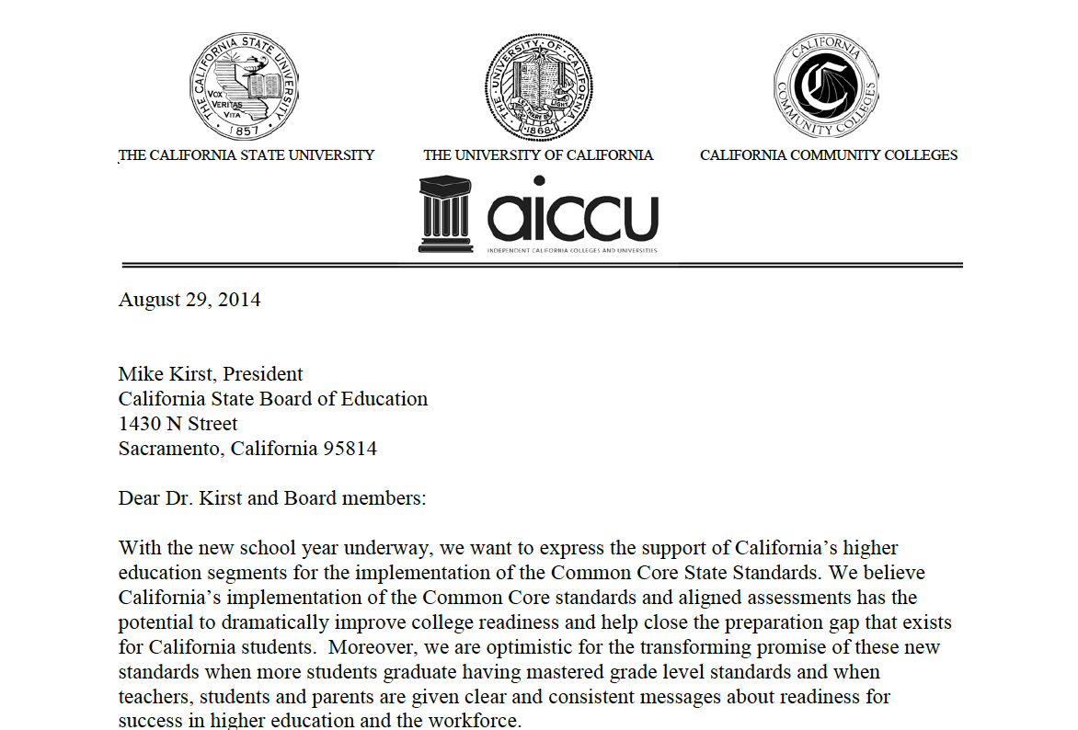

Slide 46
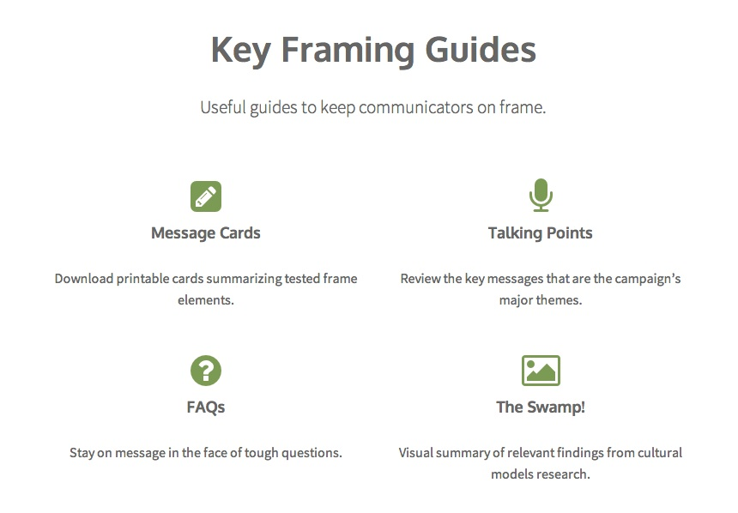
The toolkit is designed to help us tell the most effective story about CCSS goals and implementation.
Apply evidence-based frame elements to communications
Coordinate messages among the Common Core campaign partners
Answer tough questions from constituents and reporters
Identify and avoid unproductive communications frames
http://cdefoundation.org/ccss-campaign
Notes:
The toolkit FrameWorks designed for the California Common Core campaign distills all of the research into a resource filled with templates and communications strategies modeled on what we know about the most effective ways to communicate with the public about Common Core-related issues.
5 years of research; 30K people; 3K in CA designed to help change the conversation

Slide 47

Notes:
If we want to change the output, we need to change the input and the messages we’ve been using are not working.

Slide 48

Avoid the Myth/Fact Trap:
Always make the affirmative case.
In a study of the effects of myth-fact communications:
People misremembered the myths as true.
Got worse over time.
Both older and younger readers made mistakes.
Attributed false information to the CDC.
        Vedantam, Shankar. 2010. The Hidden Brain. New York: Spiegel & Grau.
Notes:
We often try to correct people’s mistakes by exposing their wrong thinking. Myths and facts sheets are one way we do this. But they don’t work they way we think they should, as researchers have documented.
“...The conventional response to myths and urban legends is to counter bad information with accurate information. But the new psychological studies show that denials and clarifications, for all their intuitive appeal, can paradoxically contribute to the resiliency of popular myths.”
Why is this so?
Because our minds don’t work literally. Instead, we re-mind people of what they thought to be true initially, and then come behind it with some exotic and unfamiliar contesting information. What do you think people remember?
But, when working to lift up one understanding of an issue rather than another, this sort of myth-fact organization is not effective with non-experts. Because of the way we process information, we are more likely to consider information we have previously encountered as TRUE. And so, the dominant understanding sticks, and the contesting frame doesn’t.

Slide 49
Basic Message Template
Notes:
When we are talking about issues, starting with values helps keep the conversation positive and focused on the right issues. But we also need to be sure we can explain what we are talking about and provide information about how we are addressing these problems.
Why does this matter?
How does it work?
What’s the goal?

Slide 50
Use a Tested Value to Establish What’s at Stake in the Common Core Implementation

Slide 51
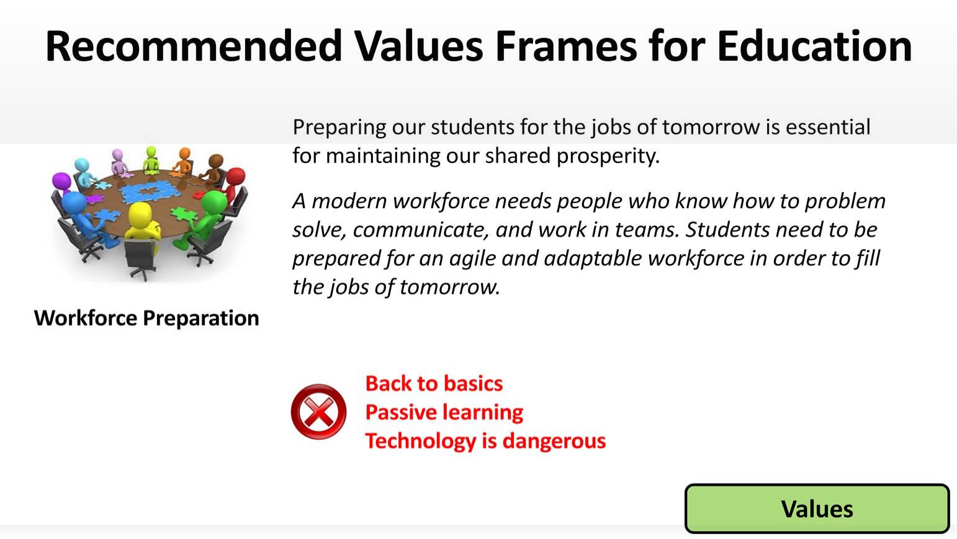

Slide 52
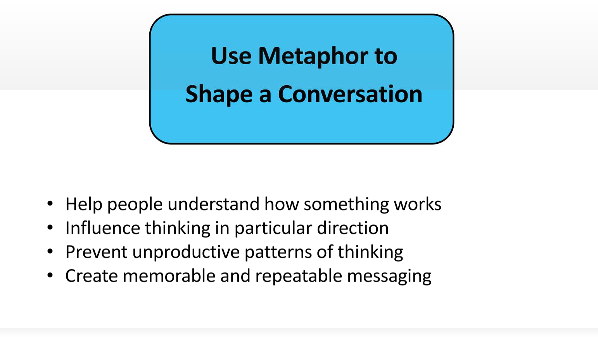

Slide 53
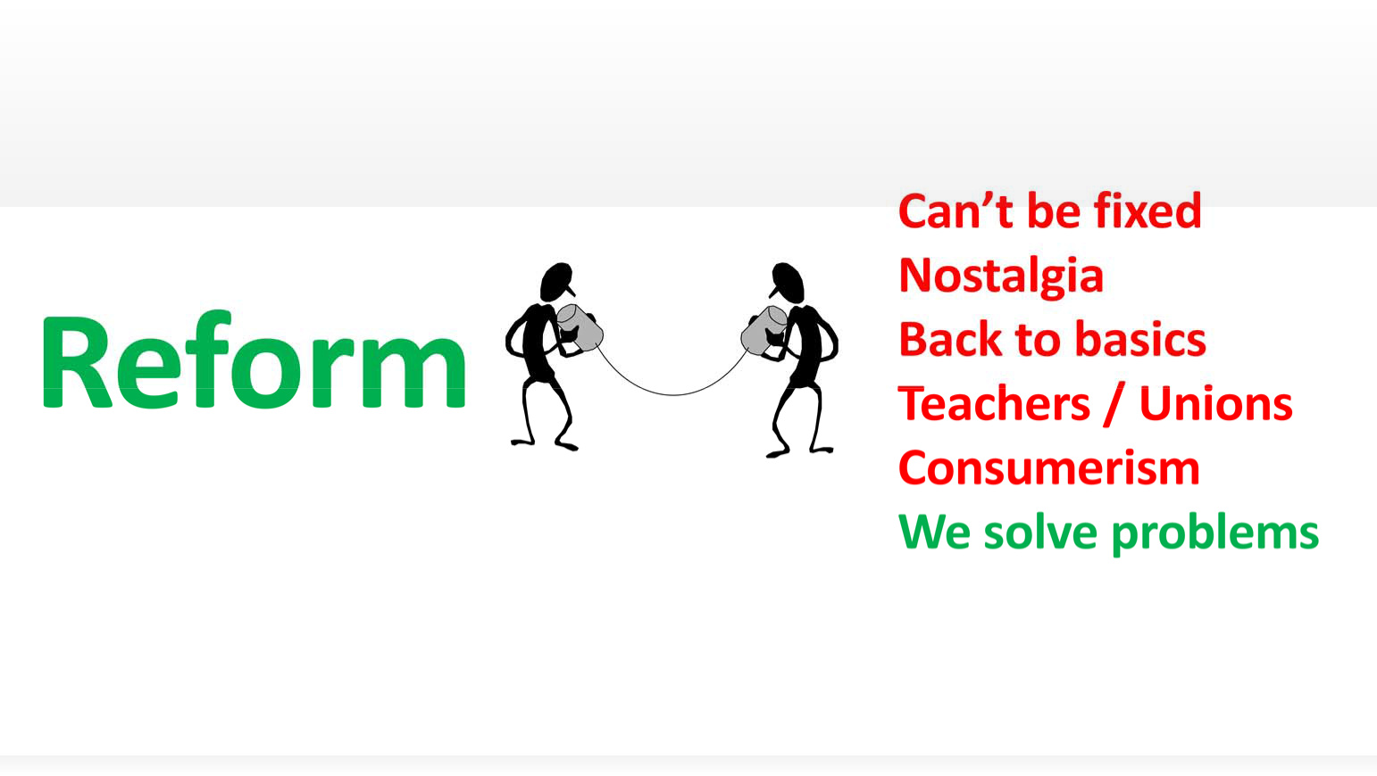
Notes:
Here’s an example of the story that the public is telling itself about public education. Instead we can talk about remodeling

Slide 54
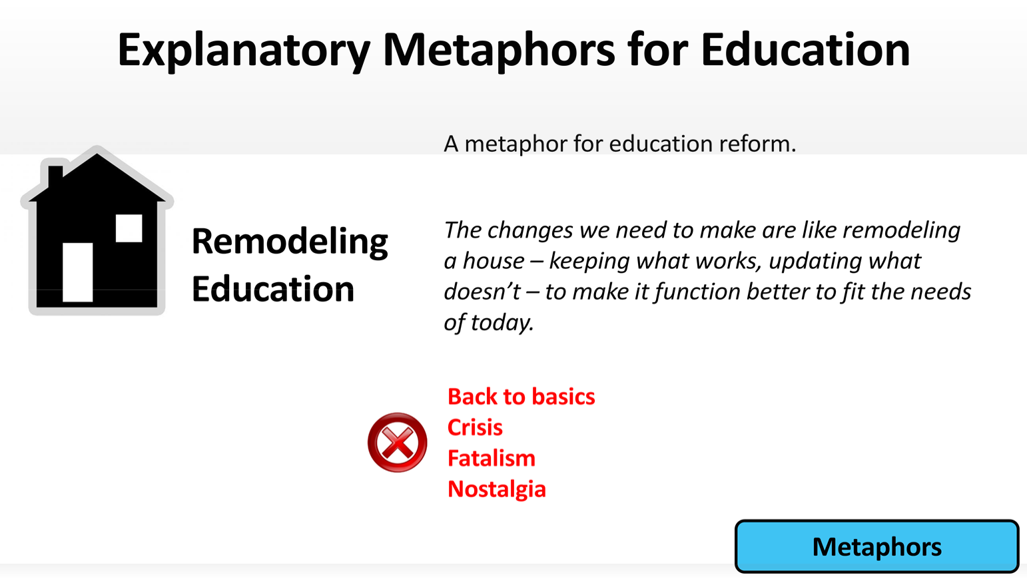

Slide 55
Local Control and
Accountability Plans
Major changes to a belief and structured finance and student outcome system
Continuum of Connections: Needs Assessment Goals Resource Alignment Services Student Outcomes
Situated in a developing, new accountability system for California
State priorities are the foundation

Slide 56
Local Control and Accountability Plans:
Guiding Principles
Performance-focused – relationship among plans, funding use, outcomes for students
Simplicity and transparency
Student-focused – local identification of needs, provide equitable opportunities
State priorities – define metrics, but rely on local determination of measurement
Stakeholder engagement – parents, students educators, broader community

Slide 57
8 State Priorities and Related Data Elements
Needs Assessment Goals Resource Alignment Services Outcomes
Student Achievement
Performance on assessments
Academic Performance Index
College and Career Readiness
English learners becoming reclassified and proficient
Advanced Placement Exams passage
Prepared through Early Assessment Program
School Climate
Student suspension rates
Student expulsion rates
Other local measures
Student Engagement
School attendance rates
Chronic absenteeism rates
Middle School dropout rates
High School dropout rates
High School graduation rates
Implementation of CCSS
CCSS implementation results for all students, including English learners
Parental Involvement
Efforts to seek parent input
Promotion of parental participation and leadership
Basic Services
Rate of teacher mis-assignments
Student Access to standards-aligned instructional resources and materials
Facilities
Other Student Outcomes
Other indicators of student performance in courses of study. May include performance and other exams.
Course Access
Student access and enrollment in courses of study

Slide 58
LCAP Actions and Services
Technical and relationship challenges
Measure progress on process and outcomes
Trust is as important as the measurement expectations
Use the local data you have as formative measures, not as a complete design this year
Process for using the metrics also needs to engender trust and rapport

Slide 59
Strong Formative Metrics
Credible: Are within your sphere of influence or control, and your schools; leadership, and community believe they will contribute to the results.
Feasible: Require data that you can realistically obtain.
Valuable: Answer the “so what” questions, go beyond activities to outcomes and goals.

Slide 60
Common Goal
Ensure that students learn what they need to know and do to be successful in life, having been well-taught by competent professionals in adequately resourced schools that are responsive to student needs.
9

Slide 61
Key Purposes of New Accountability System
Provide transparency of decision making processes in support of student achievement and outcomes.
Focus district and school leaders on significant areas for improvement and raise the sense of urgency to do so.
10

Slide 62
Key Purposes of New Accountability System
Report well-timed, accessible and actionable data for use by educators, parents, community members and policymakers.
Drive continuous improvement and allow the state to differentiate the performance of districts and schools in need of support and technical assistance.
Strengthen confidence in the educational system and return on investment.
11

Slide 63
Collective Accountability and Shared Responsibility
Student accountability
Parent responsibility
Teacher and leader accountability
Local school board and superintendent accountability
Higher education accountability
Educator preparation provider accountability
State accountability

Slide 64
New Accountability System
Build on the foundations of LCFF, state priorities and implementation of new student academic standards and assessments
Increase district and school capacity and drive continuous improvement
Focus on a broader set of outcomes than in the past, reflect more clearly what students need in order to be prepared for college, careers, and citizenship

Slide 65
New Accountability System
Decisions and actions are aligned and consistent towards ensuring students are ready for college and careers
Differentiate the performance of schools and districts in reliable and meaningful ways so they receive appropriate support and assistance
Improve performance across the systems, increase achievement and efficiency, strengthen local capacity

Slide 66
Long Term Development
State Priorities
Local Control and Accountability Plan (LCAP)
Evaluation Rubric Design Process
California Collaborative on Educational Excellence (CCEE)
Public Schools Accountability Act (PSAA)
Additional Assessments – State and Local
12

Slide 67
Resources
Nancy Brownell – nbrownell@cde.ca.gov
LCFF – WestEd Channel http://lcff.wested.org/
State Board of Education Agendas http://www.cde.ca.gov/be/ag/ag/index.asp
CDE Common Core http://www.cde.ca.gov/re/cc/
CAASPP http://www.cde.ca.gov/ta/tg/ca/
13

